Slide 1
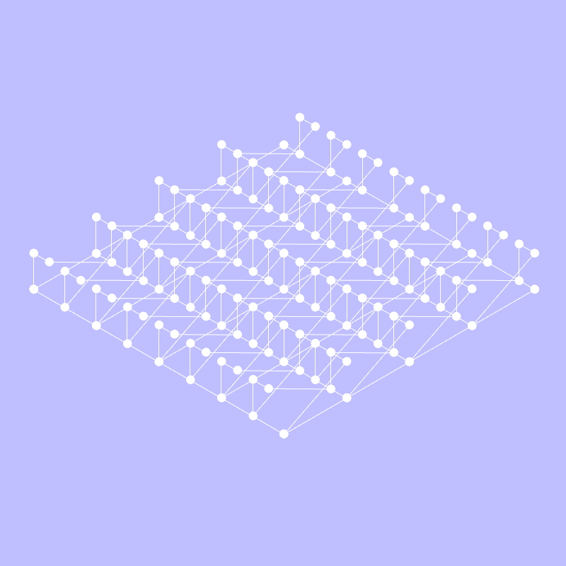
Gabled Urbanism
VIS 2225 | Assignment
Yubo Zhao

Slide 2
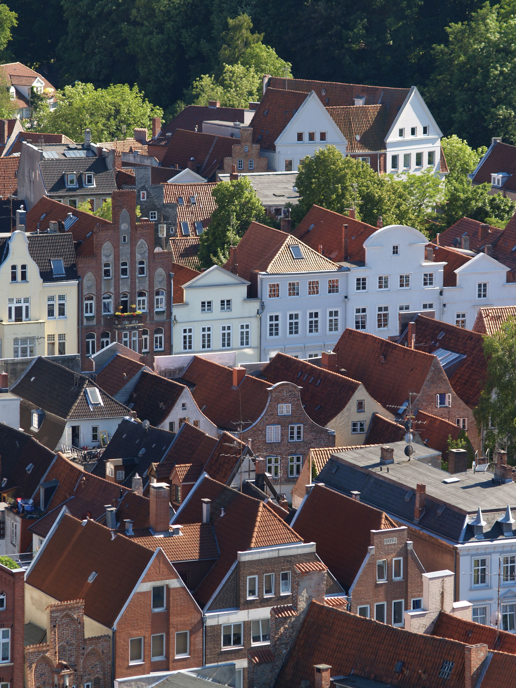
Design Goal
// This project is inspired by the urban fabric registered by a continuous landscape of gable roofs in historical European towns. The design will address this endless repetitive pattern of gable-ness through a code that makes the tool path “weave” around the mill board not only planarly but along the Z-axis as well to carve out the form.
// Image: https://www.britannica.com/technology/gable
VIS 2225 | Assignment
Yubo Zhao

Slide 3
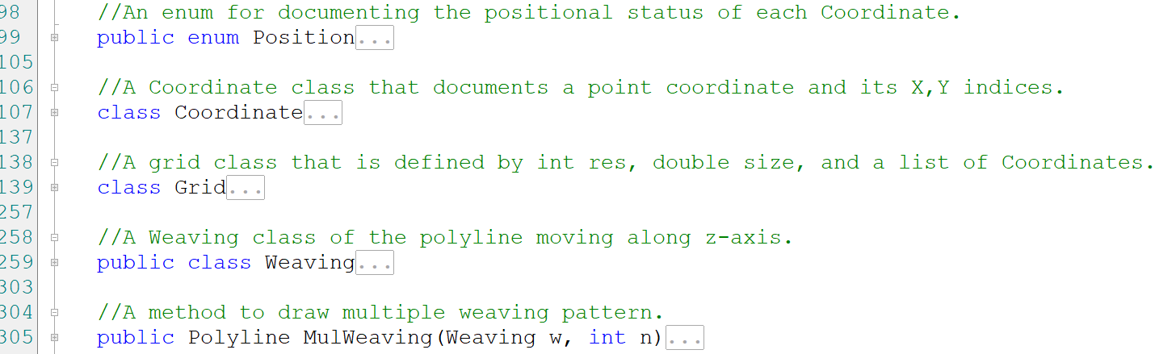
The Code | Data Structure
Final Tool Path
MulWeaving
Mapping on the grid
Add some paths to make it continuous
1
A Weaving
(start point)
A Grid
(the list of Coordinates)
2
3
The first Coordinate
A Coordinate
(iX, iY, Point3d)
…
A Coordinate
(iX, iY, Point3d)
Position
An enum class to track the positional status of every Coordinate
// The code is basically comprised of three major classes as components: the Coordinate class, the Grid class, and the Weaving class.
VIS 2225 | Assignment
Yubo Zhao

Slide 4
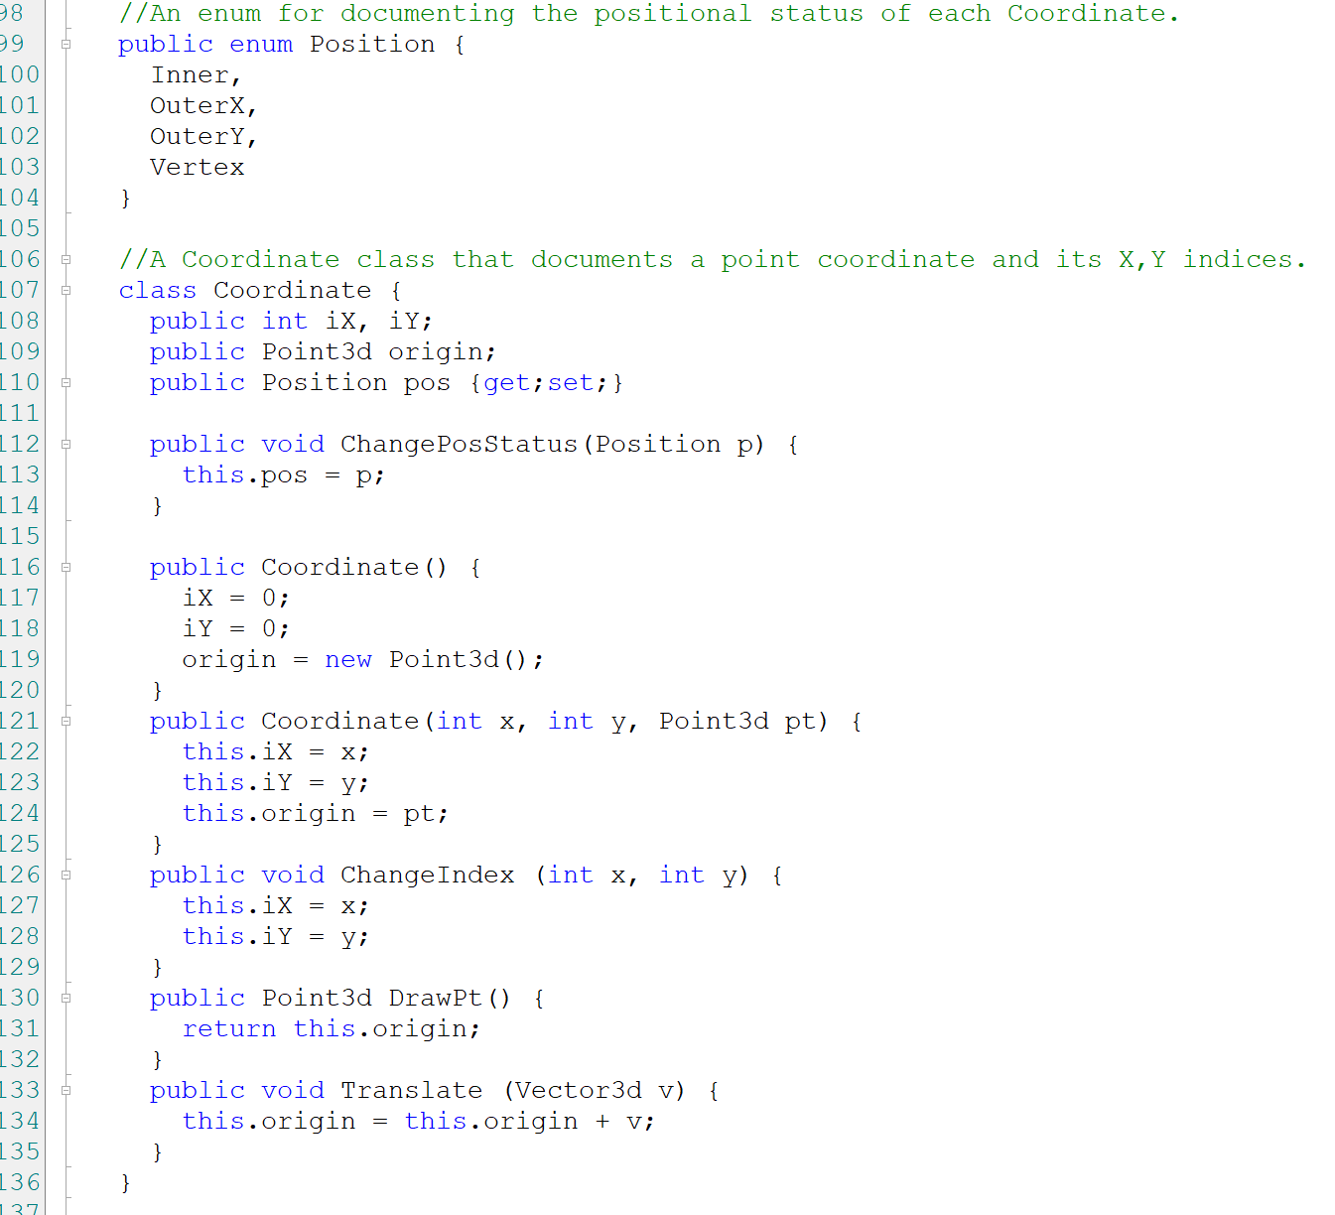
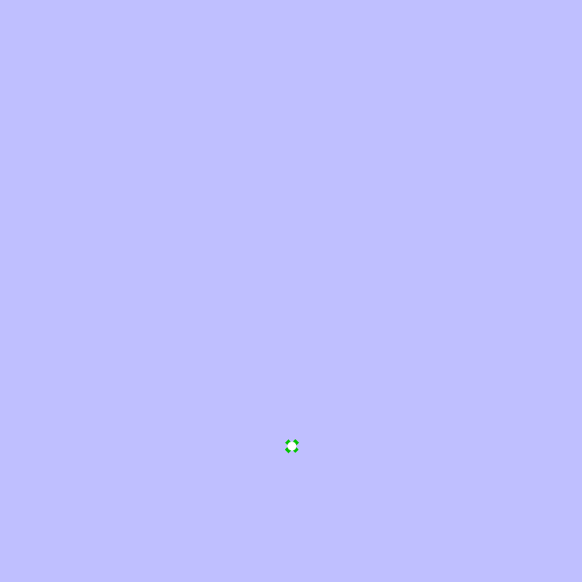
The Code | Data Structure Coordinate Class
// A Coordinate is comprised of its geometric coordinate Point 3d origin, its X/Y indices in the Grid int iX and iY, and its Positional status enum pos.
// The starting point of everything is a simple Coordinate(0, 0, Point3d()) with Position Inner.
// The Coordinate class has methods like ChangePosStatus, ChangeIndex, DrawPt, and Translate.
VIS 2225 | Assignment
Yubo Zhao

Slide 5
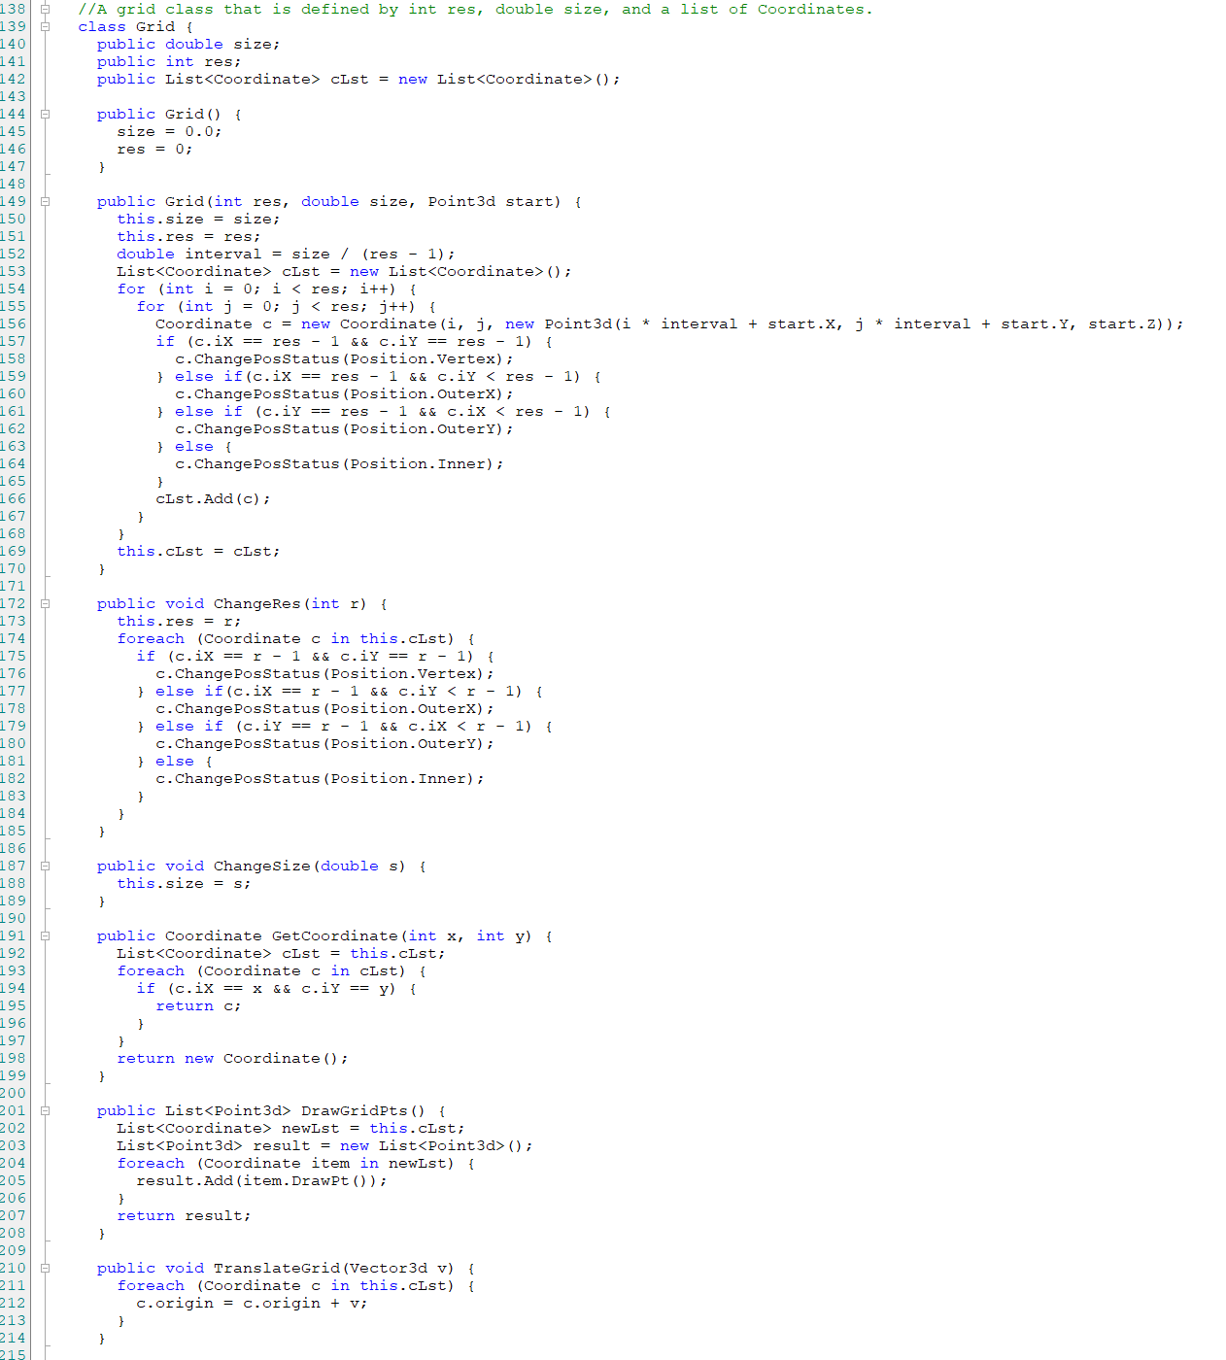
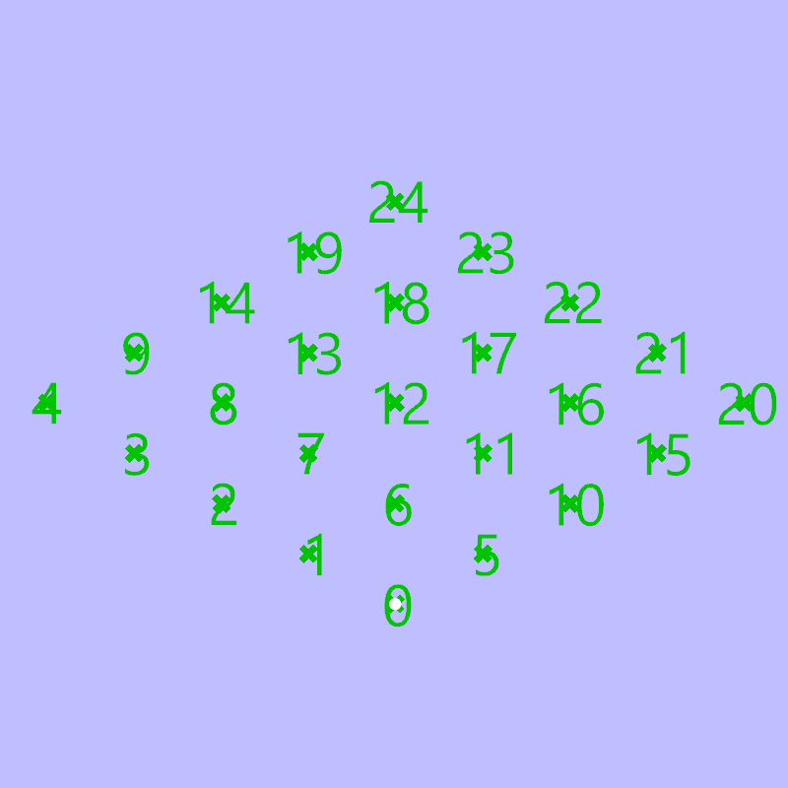
The Code | Data Structure Grid Class
// A Grid is comprised of a list of Coordinates cLst, its resolution int res, and its size double size.
// The constructor of Grid class reassigns the Position class to each Coordinate element in its cLst, for instance, the 4/9/14/19 will be assigned to OuterY, the 20/21/22/23 will be assigned to OuterX, the 24 will be Vertex, and the rest will be Inner.
// The Grid class has methods like ChangeRes, ChangeSize, DrawGridPts, and TranslateGrid.
VIS 2225 | Assignment
Yubo Zhao

Slide 6
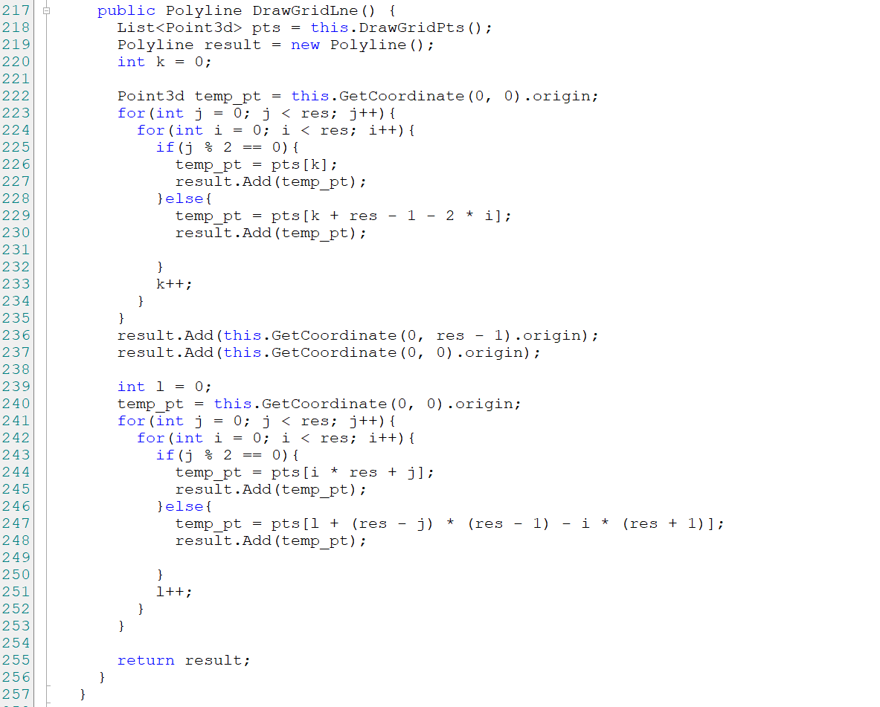
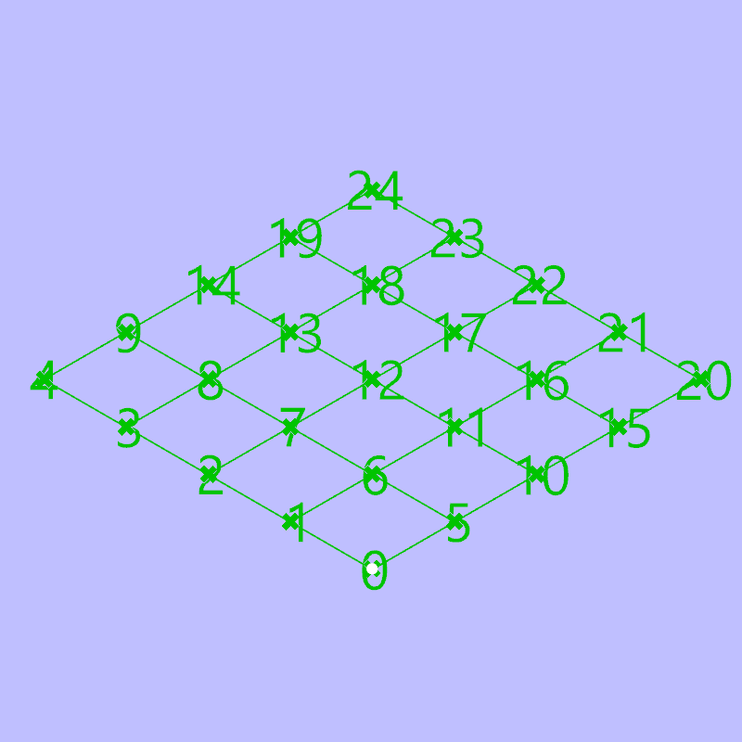
The Code | Data Structure Grid Class
// The most important method in Grid class is DrawGridLne. This method allows a continuous tool path going through the whole grid with minimal length of overlapped path.
// It basically goes as s-shape in one direction to draw the path along the Y-axis and then change its direction to draw it along the X-axis.
VIS 2225 | Assignment
Yubo Zhao

Slide 7
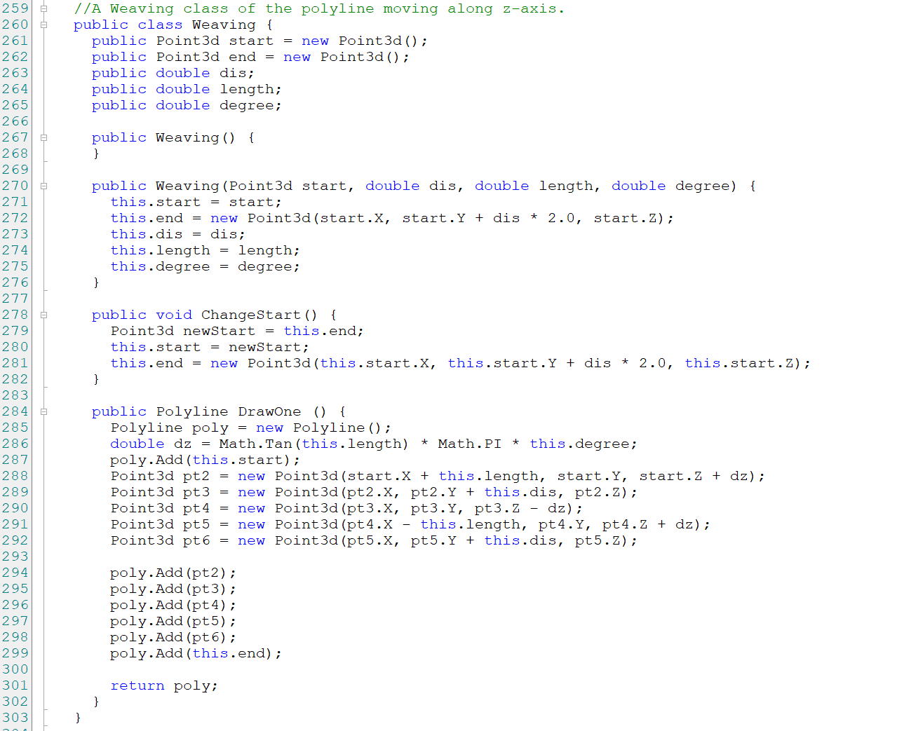
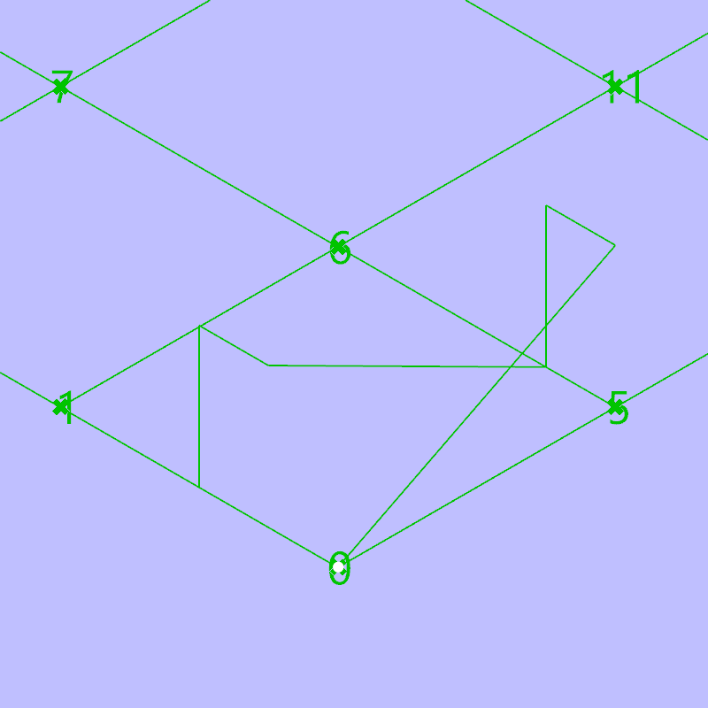
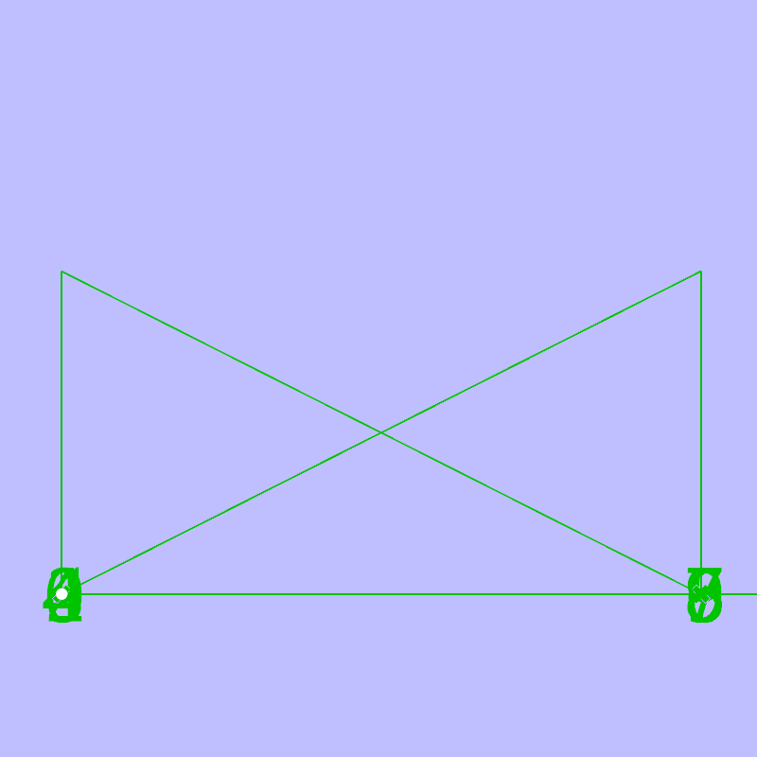
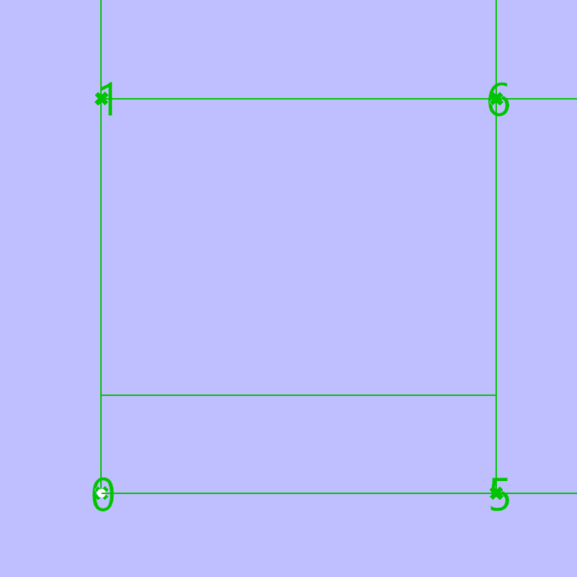
The Code | Data Structure Weaving Class
// A Weaving class generates a polyline that forms a shape of X in sectional view through its DrawOne function.
// The constructor takes a start point, the degree of the inclining angle, the distance of the turn, and the length of the whole span.
// The ChangeStart method will be used to use the current “end” point as a “start” for next Weaving segment.
length
dis
end
degree
start
degree
dis
length
Section
Plan
VIS 2225 | Assignment
Yubo Zhao

Slide 8
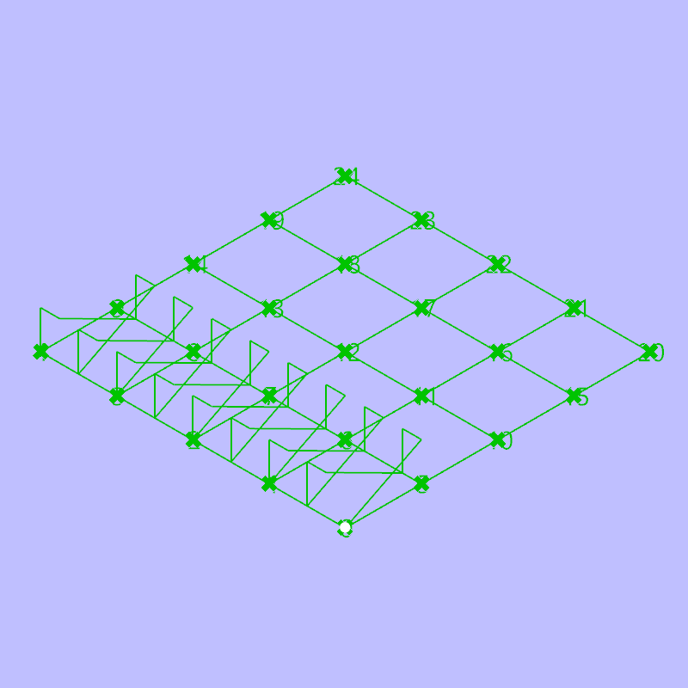
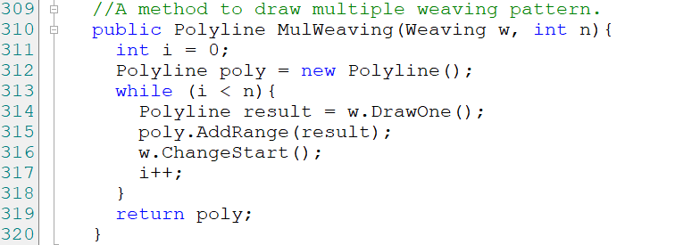
The Code | Data Structure Weaving Class
// The MulWeaving method is used to generate multiple Weaving segment into a polyline by using ChangeStart through a while loop.
VIS 2225 | Assignment
Yubo Zhao

Slide 9
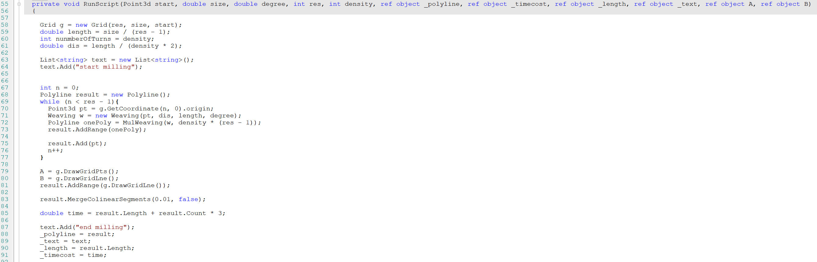
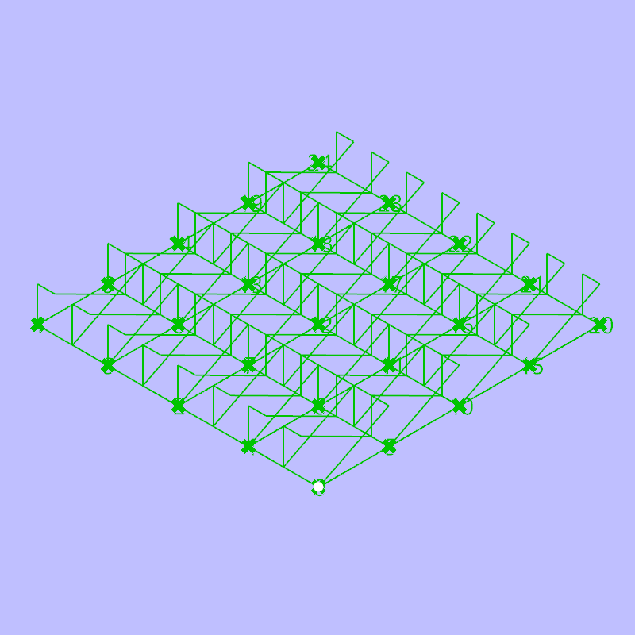
The Code | Tool Path Logic
Main Function
// Step 1: Input parameters(res, size, start point) to create a Grid.
// Step 2: Use the density parameter to set the dis variable for Weaving.
//Step 3: Use a while loop to draw multiple Weavings with the parameter degree on every column of the Grid, and make sure the tool path always return to the bottom to start drawing.
//Step 4: Concatenate two lists of polylines—the grid and the weaving pattern—and make sure that are one continuous path.
//Step 5: Calculate the time and the length.
VIS 2225 | Assignment
Yubo Zhao

Slide 10
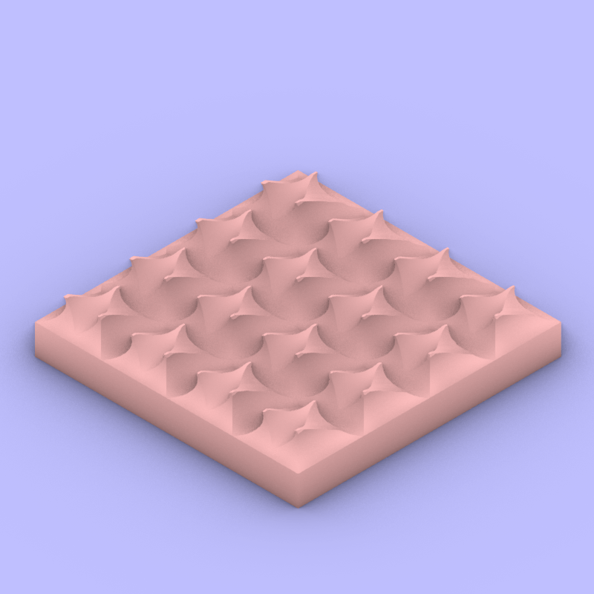
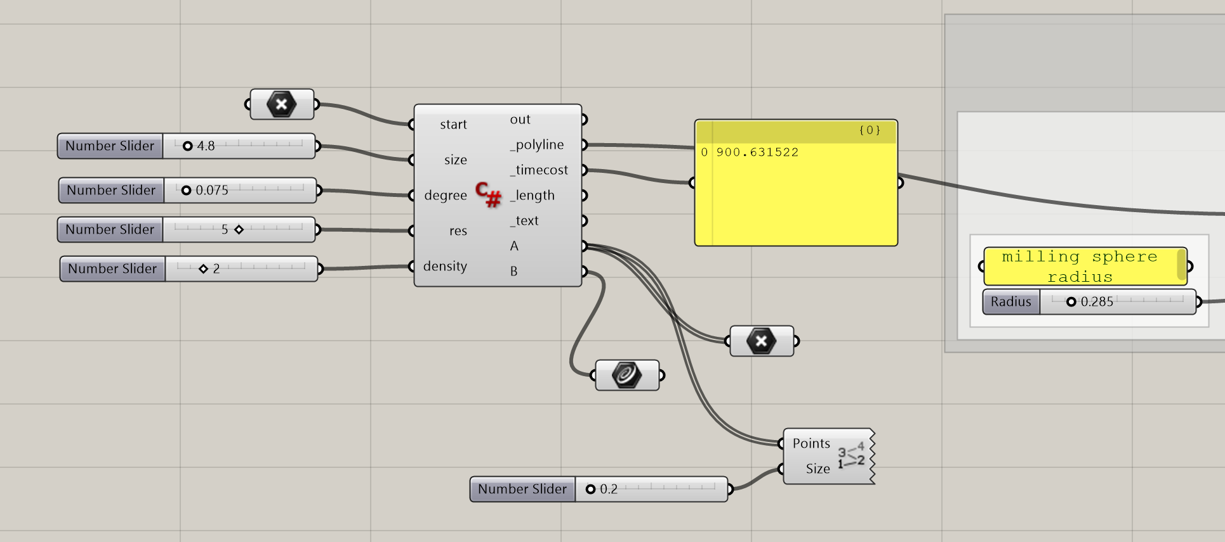
The Design | Iteration 1
A steep gabled urbanism
// Configuration:
Size: 4.8; degree: 0.075 (*Pi); res: 5; density: 2
VIS 2225 | Assignment
Yubo Zhao

Slide 11
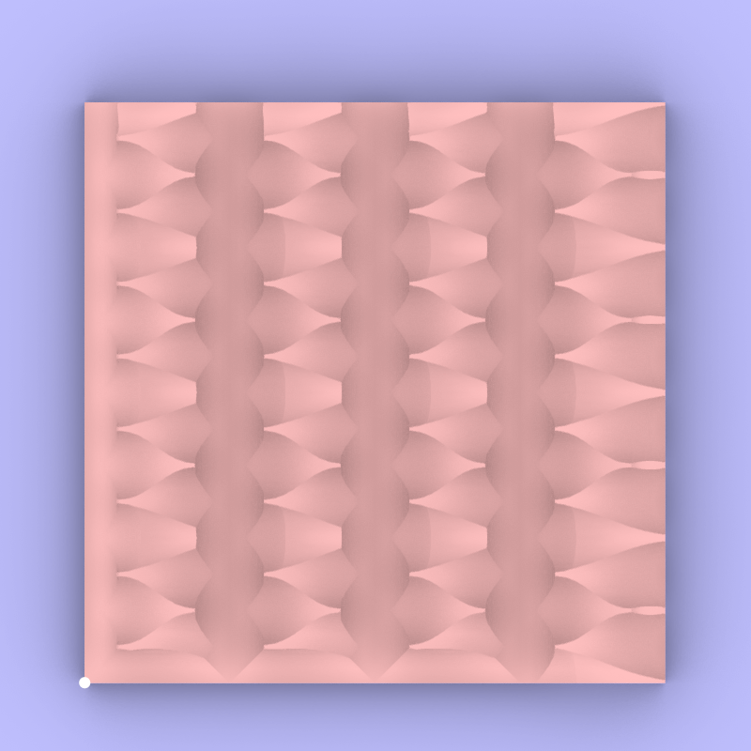
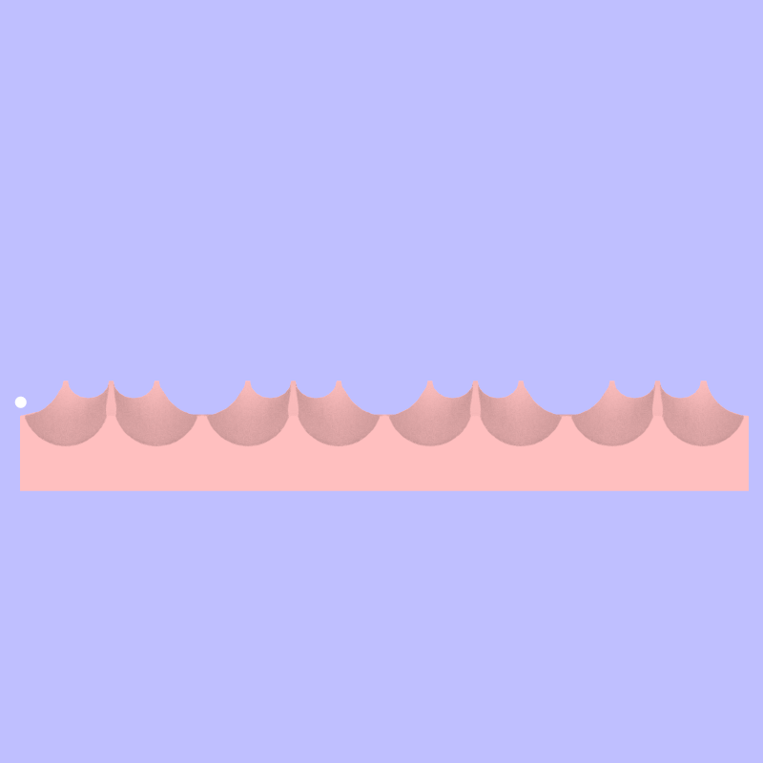
The Design | Iteration 1
A steep gabled urbanism
// Slightly adjust the grid to make sure there is not undercuts on Z-axis.
Plan
Section
VIS 2225 | Assignment
Yubo Zhao

Slide 12
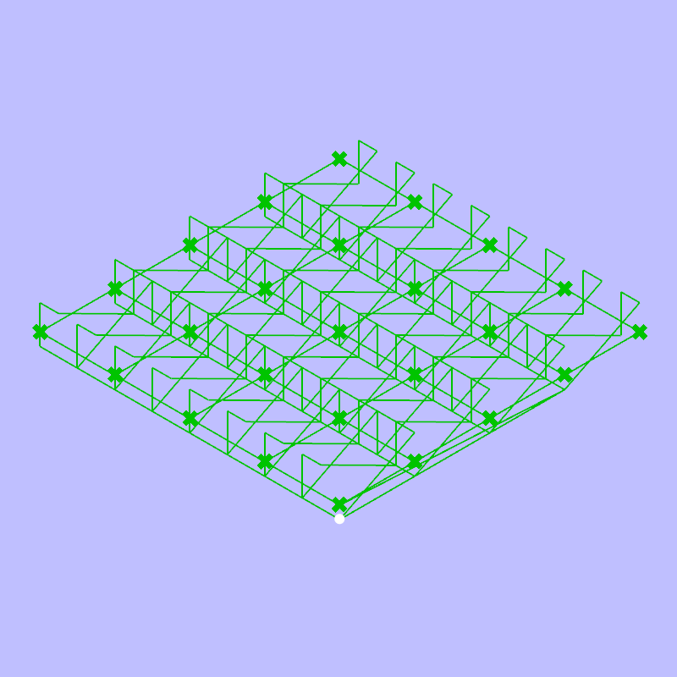
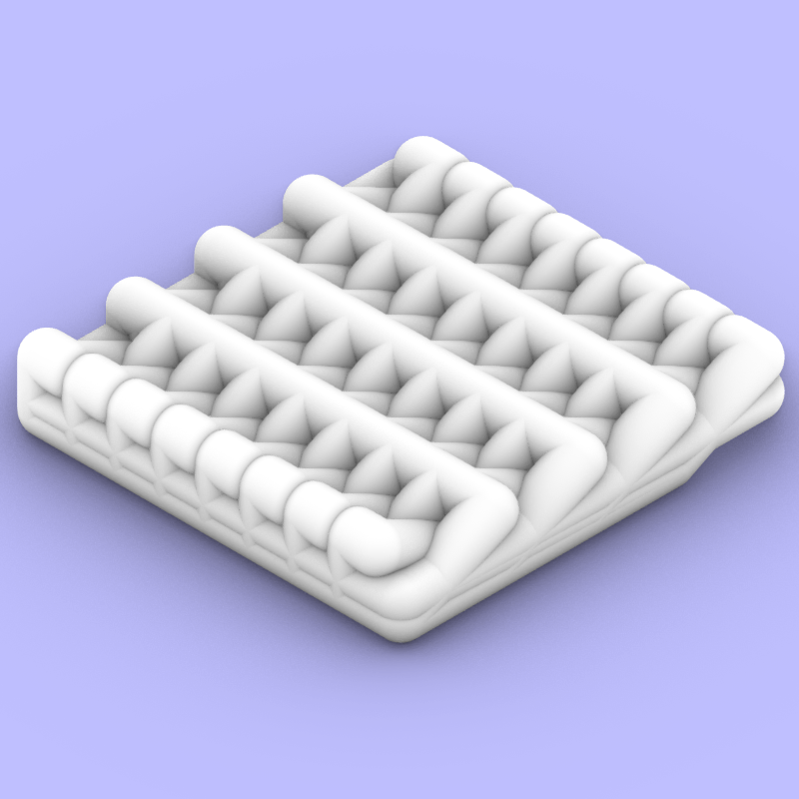
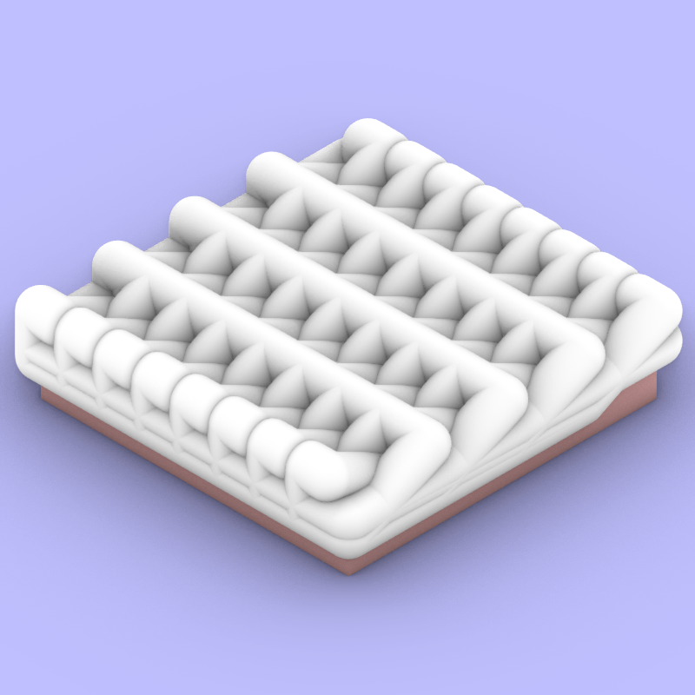
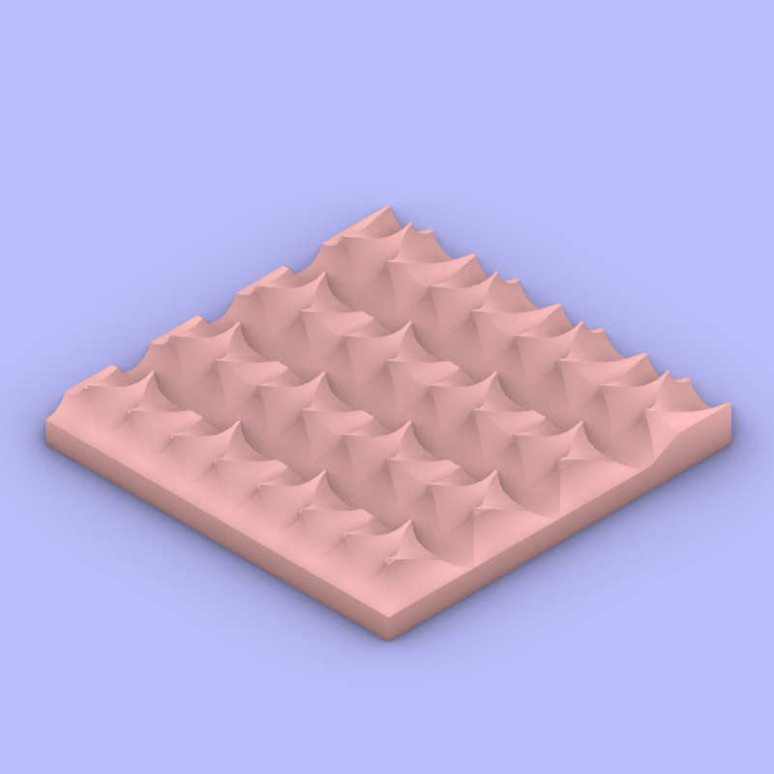
The Design | Iteration 1
A steep gabled urbanism
Tool Path
Nozzle
Boolean Out
Milled Block
VIS 2225 | Assignment
Yubo Zhao

Slide 13
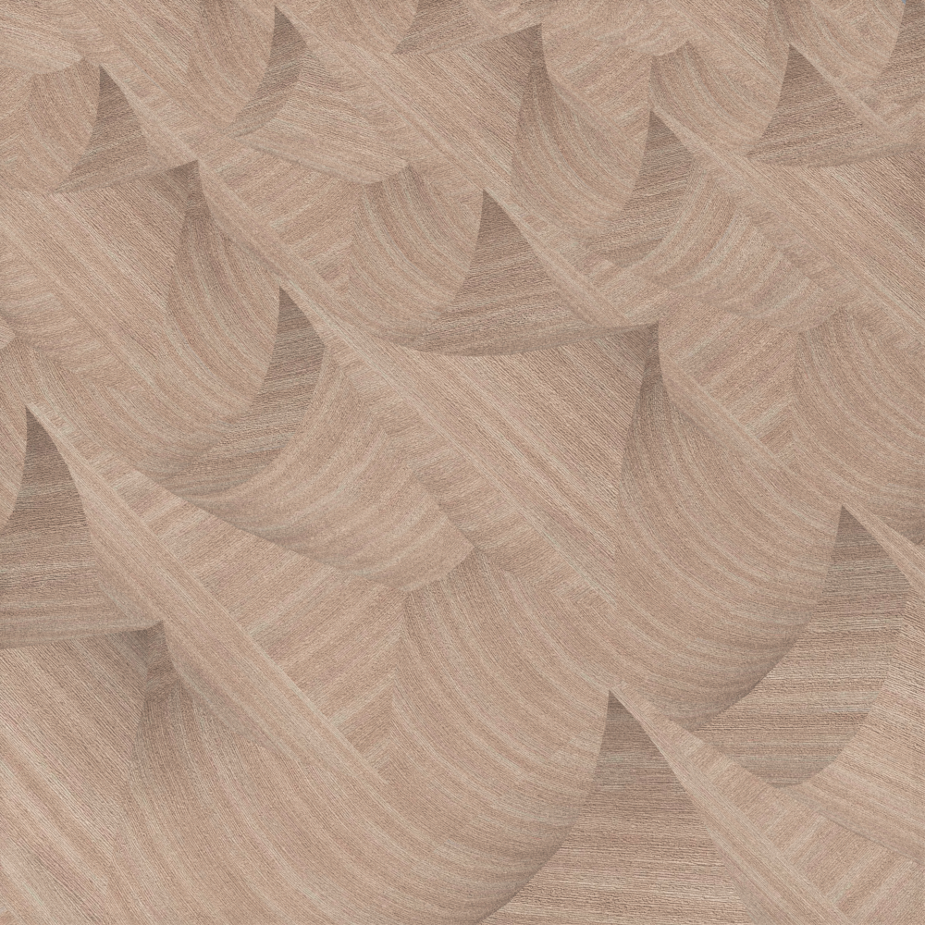
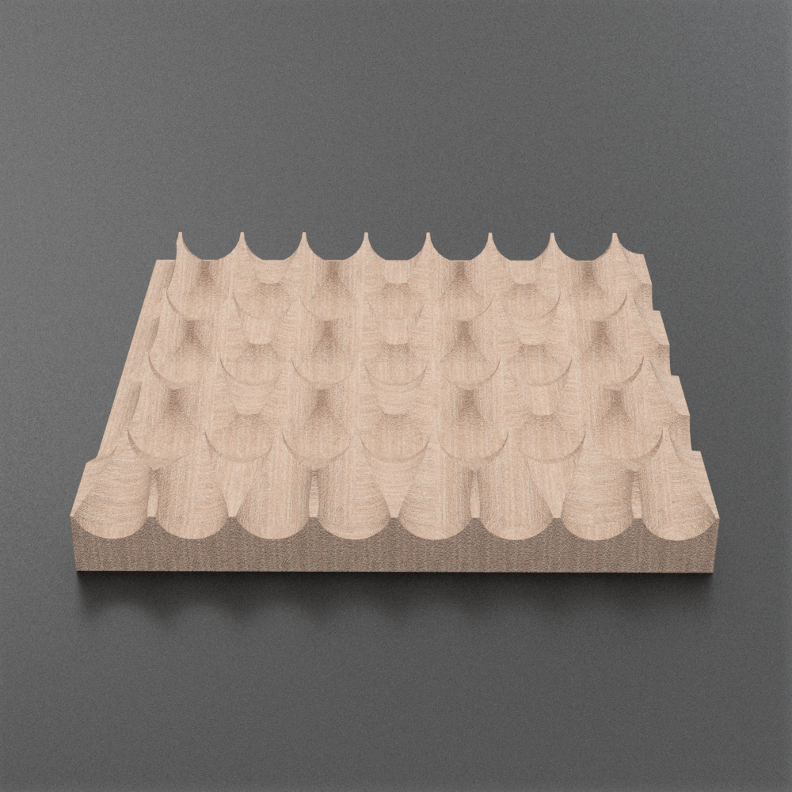
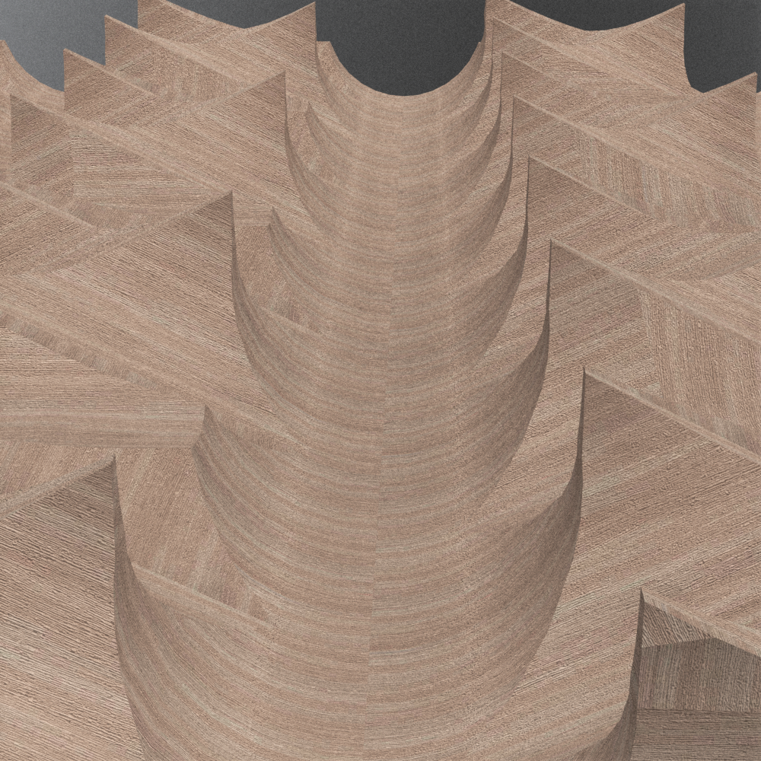
The Design | Iteration 1
A steep gabled urbanism
// This iteration creates a 4*4 city block with steep and pointy gables. At the street level a continuous set of building-scale facades is registered through the steep gables.
VIS 2225 | Assignment
Yubo Zhao

Slide 14
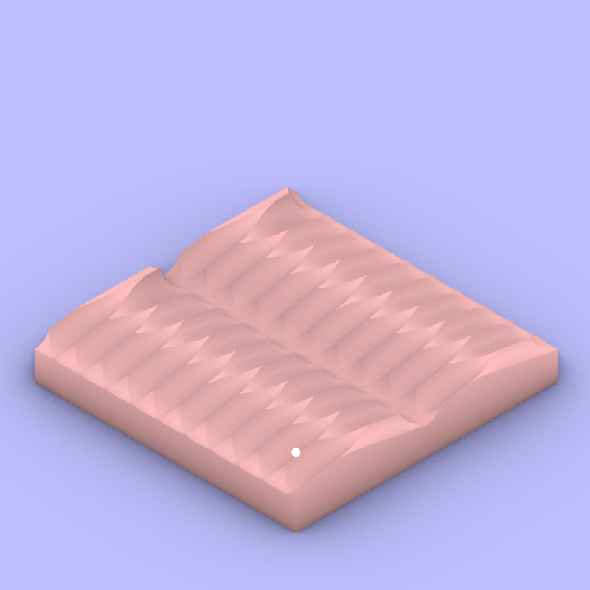
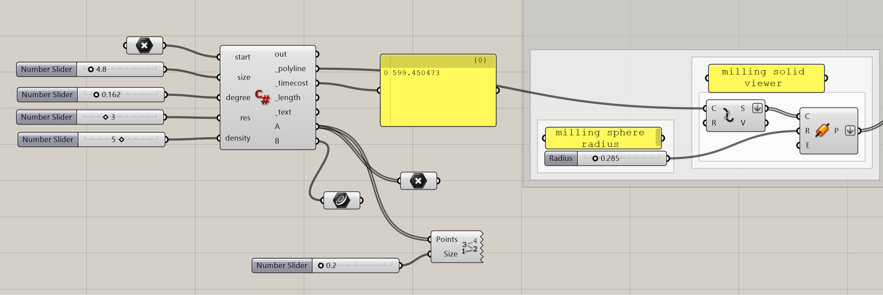
The Design | Iteration 2
A gradual gabled urbanism
// Configuration:
Size: 4.8; degree: 0.162 (*Pi); res: 3; density: 5
// Lower resolution but higher density of gables
VIS 2225 | Assignment
Yubo Zhao

Slide 15
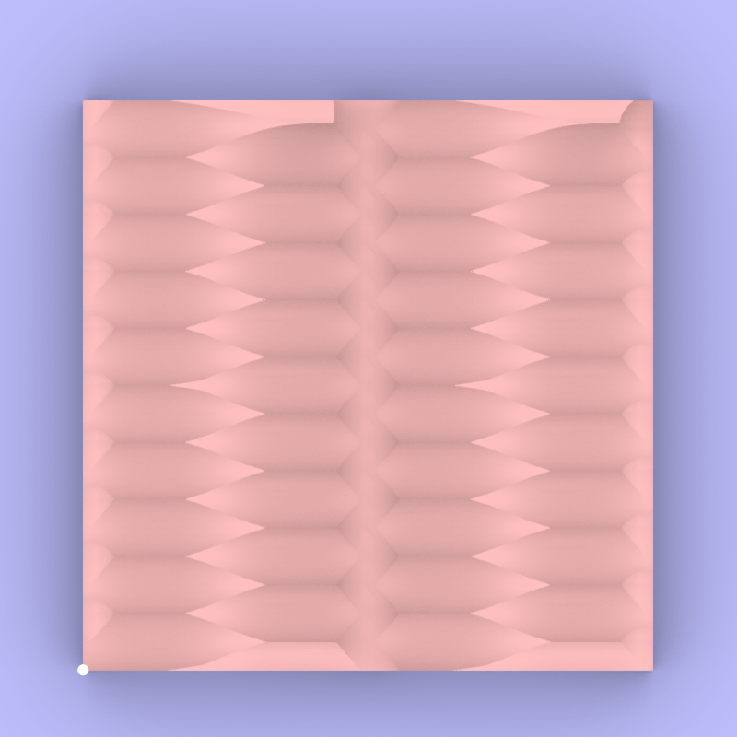
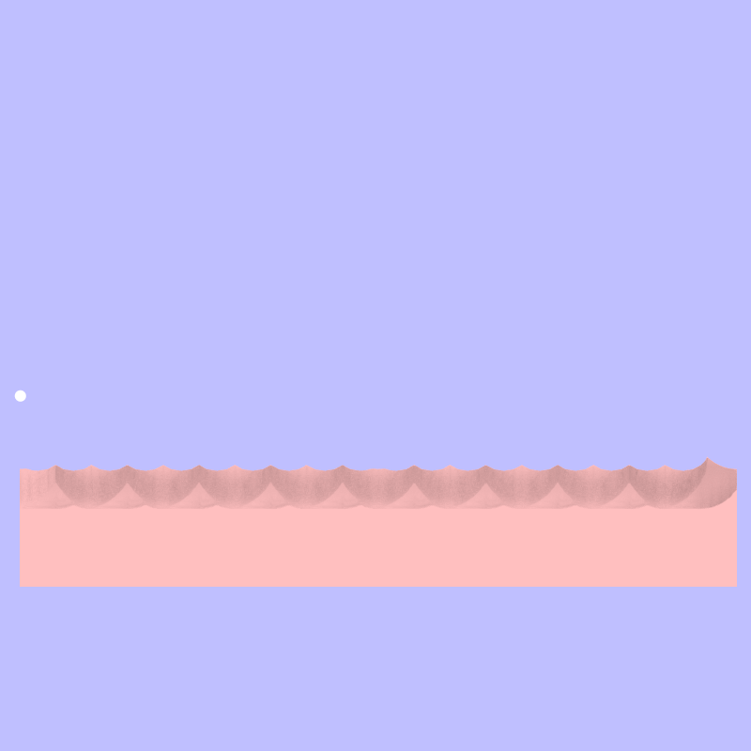
The Design | Iteration 2
A gradual gabled urbanism
// Slightly adjust the grid to make sure there is not undercuts on Z-axis.
Plan
Section
VIS 2225 | Assignment
Yubo Zhao

Slide 16
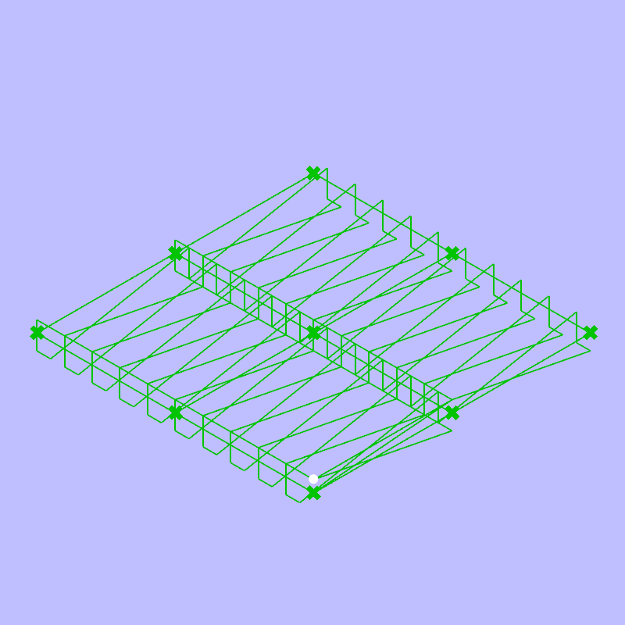
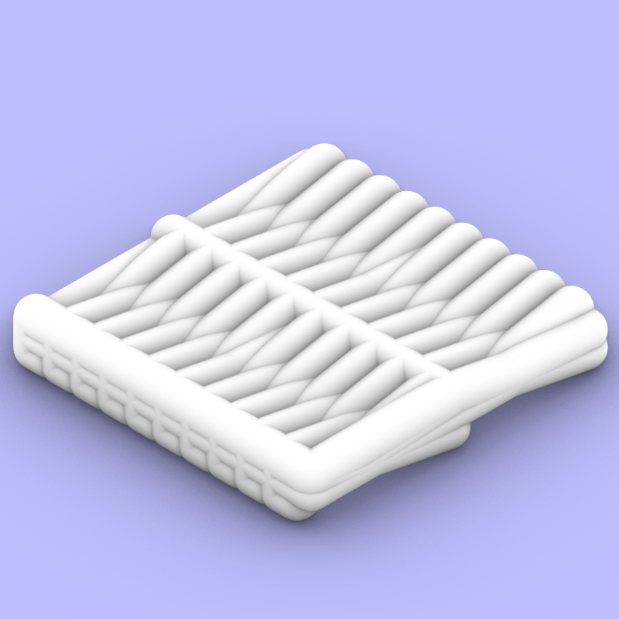
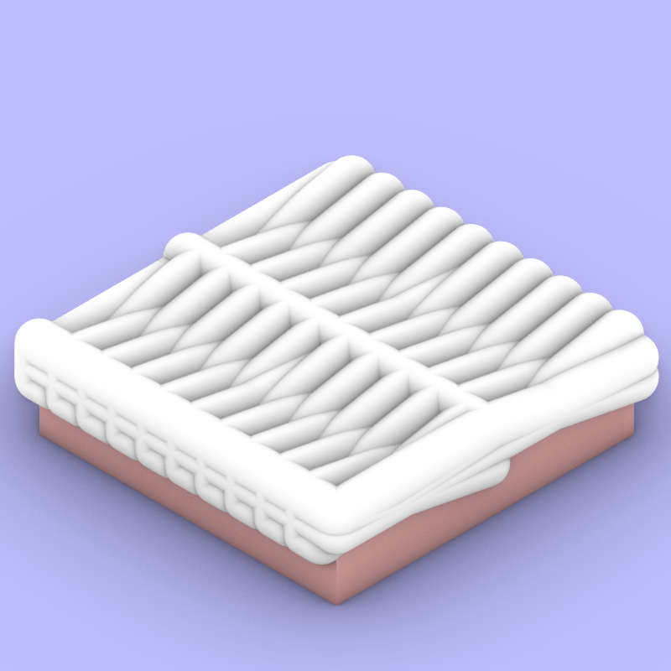
The Design | Iteration 2
A gradual gabled urbanism
Tool Path
Nozzle
Boolean Out
Milled Block
VIS 2225 | Assignment
Yubo Zhao

Slide 17
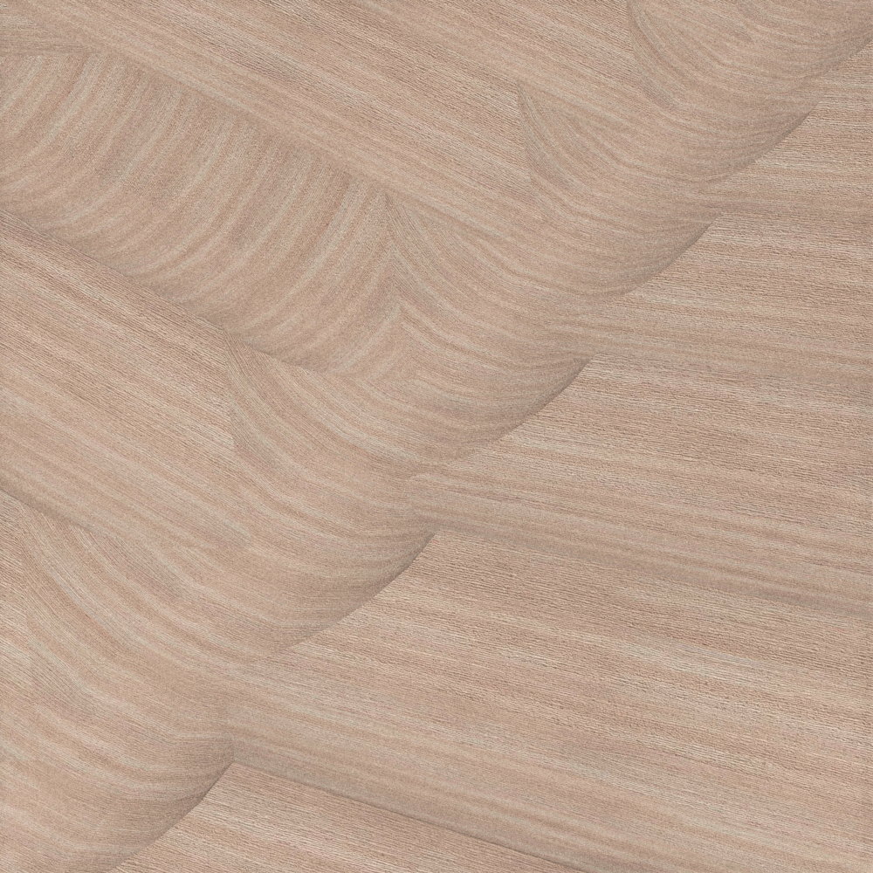
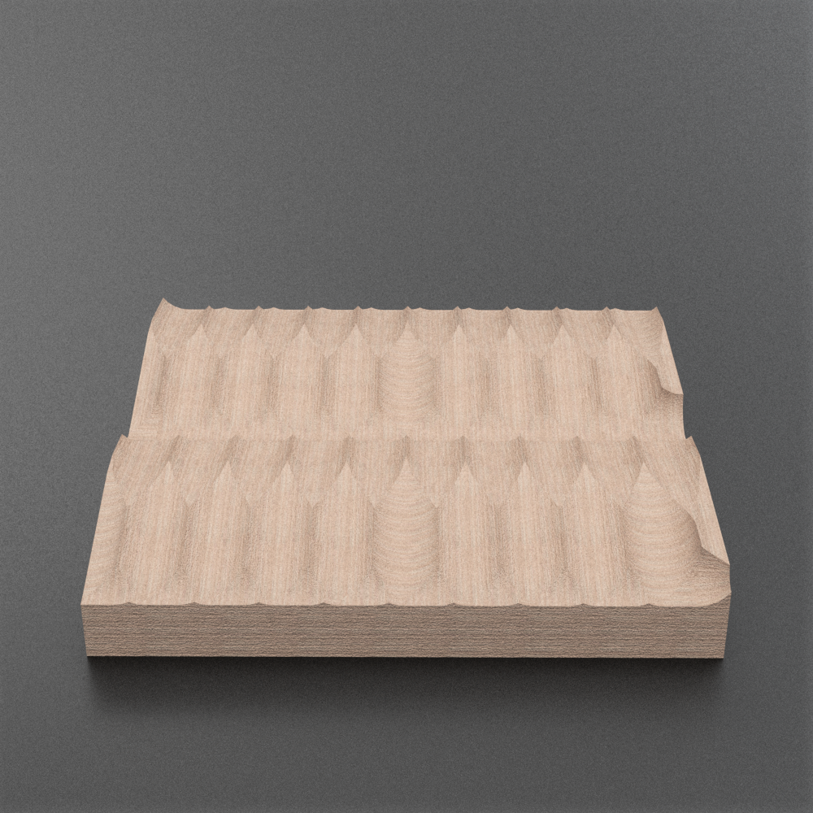
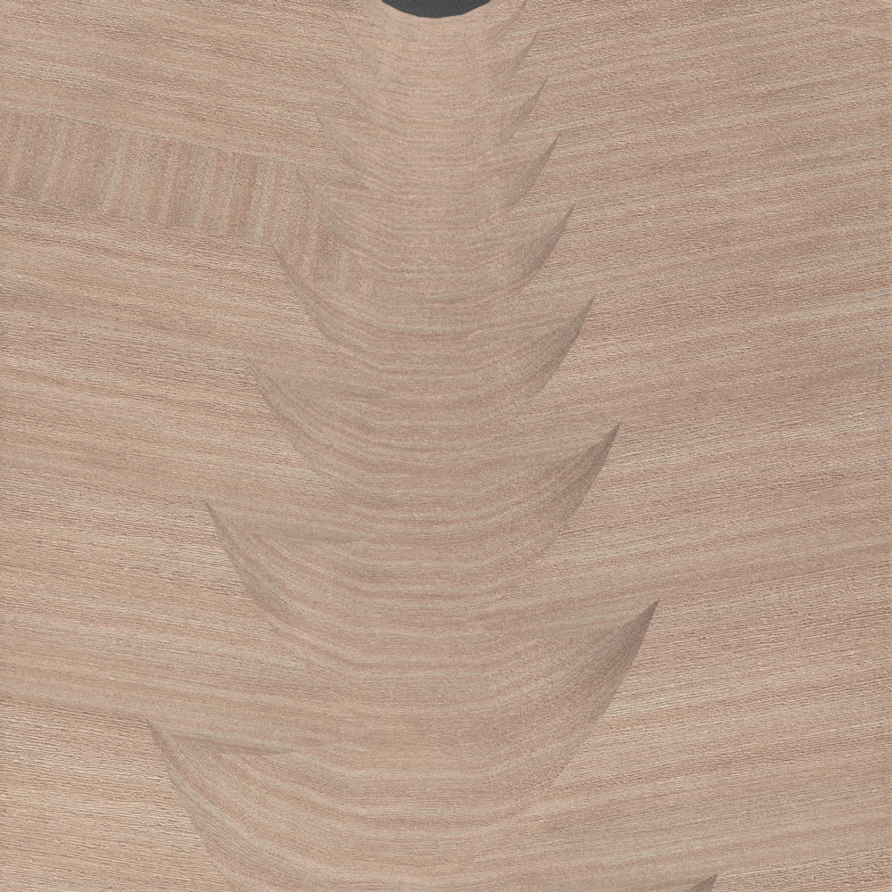
The Design | Iteration 2
A gradual gabled urbanism
// This iteration creates a 2*2 city block with gradual and flat gables. At the street level the gables have not become architecture yet but remains in a semi-landscape and semi-building formal gesture.
VIS 2225 | Assignment
Yubo Zhao

